Slide 1
Building Your Team to Last
Sarah Withee
@geekygirlsarah
geekygirlsarah.com/buildyourteam
Notes:
Intro
Definitely tweet along if you want

Slide 2
Have you had an onboarding experience that wasn’t that good?
Notes:
[READ]

Slide 3
Have you had an onboarding experience that was horrible?
Notes:
[READ]

Slide 4
Tell your neighbor about your worst just-hired experience.
Notes:
[READ]

Slide 5
Hello!
I am Sarah Withee
(aka geekygirlsarah)
Software engineer at Arcadia.io
Notes:
[READ]

Slide 6
Outline
Intro
Choosing Good Team Members
Great Onboarding Experiences
Effective Mentoring Practices
Iterate and Improve
Conclusion
Notes:
[READ]

Slide 7
Who?
Developers/Designer/Writers/other team members
Managers/Scrummasters/etc.
Junior-level people
Senior-level people
… basically anyone on a team
Notes:
[READ]

Slide 8
Disclaimer
Based on my perspectives as a software engineer
Can apply to any type of team or role
Notes:
[READ]

Slide 9
Intro
Why is this important? It’s not even my job!
Notes:
You might possibly wonder why you should worry about all of this stuff.
You might not be a manager
Or in HR
Just a lowly grunt low on the hierarchy

Slide 10

This started as…
Notes:
This started out as a rant
Talked to too many friends on Slack, Twitter, and in real life
SO MANY terrible stories of their work places
It drove me mad

Slide 11
Why are these teams terrible!?!?
Notes:
Why are these teams terrible?
What can we do about it?
I proposed this talk to a conference couple of years ago
Since then, I’ve learned even more about teams and what works as I’ve went through 8 month job hunt

Slide 12
Choosing Good Team Members
Or: How not to choose another grumpy cubemate that whines about your bad music
Notes:
The process of building a good team starts before you even try to build it
There are many things to think through before trying to hire a new person or fill a gap that opened up

Slide 13
Choosing Good Team Members
Ask the team what they feel is missing
Notes:
Sometimes it’s obvious… C# dev left, you need a C# dev
Sometimes it’s not… you need a new team member of some sort

Slide 14
Choosing Good Team Members
What tech expertise do you need?
What skillsets do you feel would be helpful?
But also: What traits do you feel you need? A good experienced architect? A creative mind?
Is there something you feel the team is lacking?
Notes:
Sometimes it’s obvious… C# dev left, you need a C# dev
Sometimes it’s not… you need a new team member of some sort
What tech expertise do you need?
What skillsets do you feel would be helpful?
But also: What traits do you feel you need? A good experienced architect? A creative mind?
Is there something you feel the team is lacking?

Slide 15
Choosing Good Team Members
Advertise the role correctly
Notes:
[READ]
And I emphasize “correctly”

Slide 16
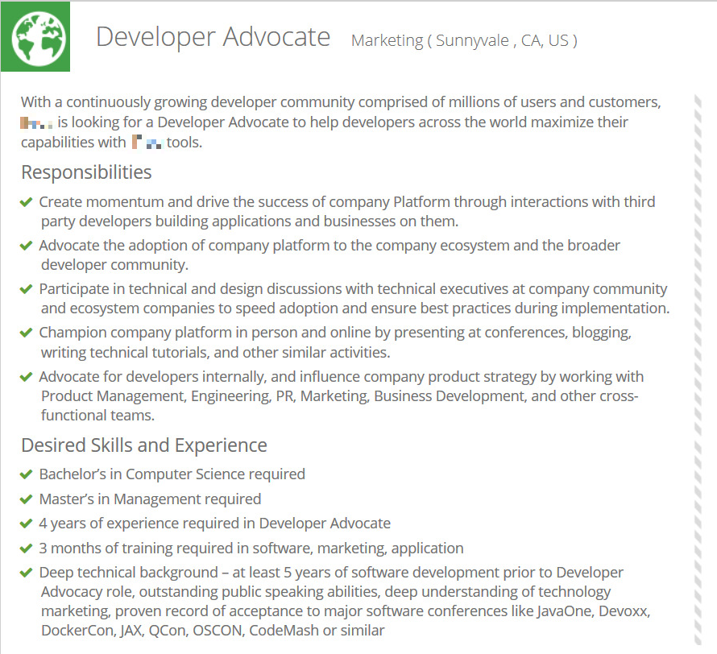
Actual job description I was told to apply for
Notes:
This is from an actual developer advocate role I was asked to apply to
Description is:
Bachelors in computer science
Master’s in management
4 years of experience in being a dev advocate
3 months of training required in software, marketing, application
Deep technical background with at least 5 years of software development before your 4 years of experience as a developer advocate
Outstanding public speaking abilities
Deep understanding of technology and marketing
Proven record of acceptance to major software conferences including [list of big name conferences]
It’s unreasonable for what the job turned out to be because after interviewing me, they considered me a fit. I meet like 1-2 of those
Even worse, it wasn’t what they even wanted in the end. They took this down later and replaced it with something different.
I looked on there yesterday and the position is back up and it’s a small fraction of the requirements
THIS is preposterous. Be accurate! Be descriptive of

Slide 17
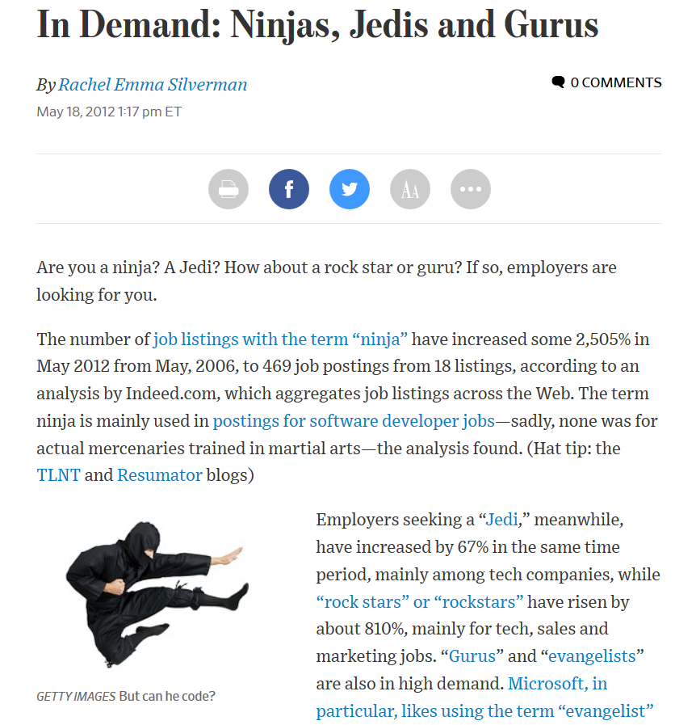
https://blogs.wsj.com/atwork/2012/05/18/in-demand-ninjas-jedis-and-gurus/
Notes:
This is an article from the Wall Street Journal in 2012. They said that:
From 2006 to 2012:
Jobs with “Jedi” increased 67%
Jobs with “rockstars” increased 810%
Jobs with “ninja” increased 2,505%
Not counting mashups like “badass rock star code ninjas”
Are there people that might feel turned off by these terms?
More important: do these really tell what the job is?
Put down things your team HAS to have
Other things might be preferred ideas. “Nice to know C# but knowing Java would work”
Be as specific as you can. If it’s a role that may swap teams or projects, you can be more generic too. But still be truthful

Slide 18
Choosing Good Team Members
Have standard and fair rubrics for comparing candidates
Notes:
[READ]

Slide 19
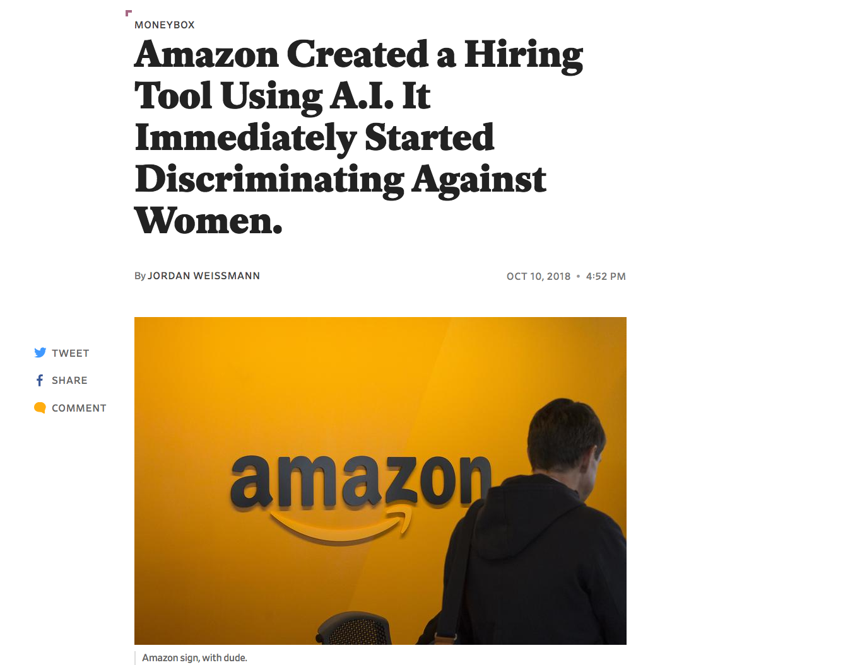
https://slate.com/business/2018/10/amazon-artificial-intelligence-hiring-discrimination-women.html
Notes:
This Slate article talks about Amazon using AI software on resumes to predict the “best” candidates.
Turns out that women were immediately turned down.
Basic tech skills like writing code were turned down.
Macho words like “executed” and “captured” were favored.
There’s studies that show people are entirely biased on candidates based on name, gender, age, and so on
While we want to keep some things in mind, you really want to judge them based on fair criteria
Think this through and establish it before you start interviewing

Slide 20
Choosing Good Team Members
Get team involved in interviewing
Notes:
Some of the best interviews I’ve ever had is where I talked to what would be my ACTUAL future manager or ACTUAL team members
At New Relic, I flew to Portland and I had chats with some team members, pair programmed with others, and lunch with all of them
At Square, I talked to the actual manager that was going to hire me
At Arcadia I chatted with the whole team and pair programmed with the manager
My worst interviews were usually coding exercises that nothing to do with the job and with people I would have no involvement with later
Getting a feel for your team is important. You aren’t just doing work with them, but you’re in meetings, you’re collaborating. This is important!
If you’re not doing this, start pushing for it

Slide 21
Choosing Good Team Members
Look for diversity
Notes:
It’s important to get a blend of diverse traits. Why? Studies show the more diverse teams build better products.
I’ve been in on meetings where everyone was senior developers and I was a junior, and I came up with solutions that were not only less complicated, but WAY more efficient

Slide 22
Diversity Traits
Age
Gender
Ethnicity
Experience levels (junior, mid, senior)
Breadth of experience (expert vs. jack-of-all-trades)
Backgrounds (financial, location, etc.)
Notes:
You want a blend of things.
You probably can’t get ALL of these, especially with only 5 or so people
But you CAN get some of them, and that will yield the most importance
My team hired someone else and I at the same time.
I provided a really wide breadth of experience and would bring a lot of ideas and solutions to the table
The other new coworker provided a really deep experience in designing needed systems
Both of these were things this team needed
Note what your team lacks on these traits, and keep that in mind when you hire someone
Use it more as a final deciding factor than a “we need to hire someone young”

Slide 23
Choosing Good Team Members
Consider juniors or interns
Notes:
It seems to be a thing I see a lot that companies and teams want the already experienced people
That can be fine, but there’s a TON of benefits to everyone by bringing on fresh talent
So on a minor side track:

Slide 24
Benefits of Juniors/Interns
Grow in experience
They put their energy to good use
They discover their interests
Notes:
You learn WAY more from an internship than from school
They’re eager to learn and usually full of excitement. USE that energy!
They get to discover what they are interested in. Did you know right after school what you liked to work on?

Slide 25
Benefits of Juniors/Interns
Build good relationships with experienced people
Cheaper/easier to hire
Eager to get involved in the workplace and community
Notes:
Networking is valuable. It’s great for them to meet more people, but also to see how experienced people work.
This is usually why people want to hire them. They ARE cheaper and easier to hire.
When was the last time you got another company outing email and you said “eh, not worth it.” They usually want to do these things, which looks good for the team and company

Slide 26
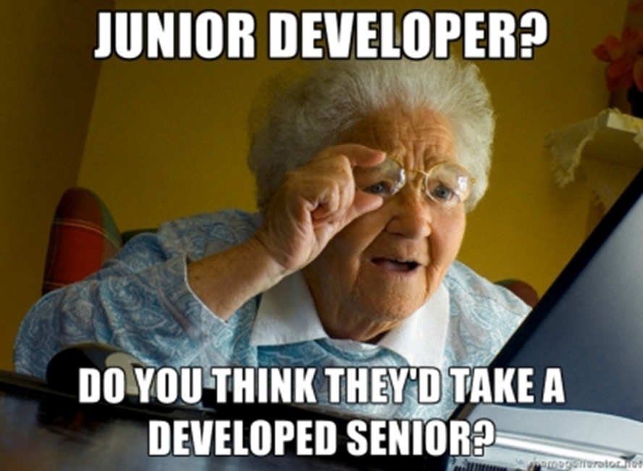
Notes:
[PAUSE}

Slide 27
Benefits for Teams
Time away from regular work
Reevaluating how team does things
More time spent in beginning saves MORE time down the road
Notes:
Seriously, how many times have you been so wrapped up in your project that you wanted a break? Helping them get started can be that break!
Having a fresh face look at how things work is a perfect way to find out what terrible processes you have in place.
It seems counterintuitive, but if you spend more time up front, they’ll be more solid when they work on their own. You’ll get more time later and not get interrupted as much

Slide 28
Benefits for Teams
See new ideas and technologies
Break out of homogeneity
Investing in the future of your team
Get more side work done
Notes:
It’s not always easy to transition to new tech, but it’s even harder when you don’t know what it is. (Let’s face it, it’s hard to keep up with it all. Even here I’ve learned new things I didn’t know how to do.)
Ever feel you’re in a rut? Fresh new ideas can help break that.
It’s hard to think about the team’s future, but building an intern up early and giving them a good experience means they’ll likely want to return to your company. And that’s a SUPER easy hire. They already know what they’re doing!
Does your team have things they wanted to do but no real time to do? Give those projects to new people! They can help aid in productivity in ways you didn’t expect.

Slide 29
Choosing Good Team Members
Ask the team what they feel is missing
Advertise the role correctly
Have standard and fair rubrics for comparing candidates
Get team involved in interviewing
Ask the right questions
Look for diversity
Consider juniors or interns
Notes:
In summary…

Slide 30
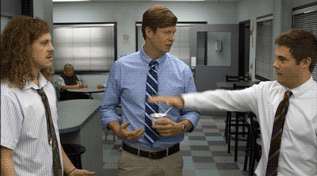
Notes:
With this, you can now enter into the next phase of this process…

Slide 31
Great Onboarding Experiences
Not: Here’s your computer, go sit in the corner and do something
Notes:
You’ve hired someone! Now what?
You have to bring them onboard. This can be good or bad, but usually it’s rather… meh.
It’s usually some combination of good and bad from what I’ve seen
…

Slide 32
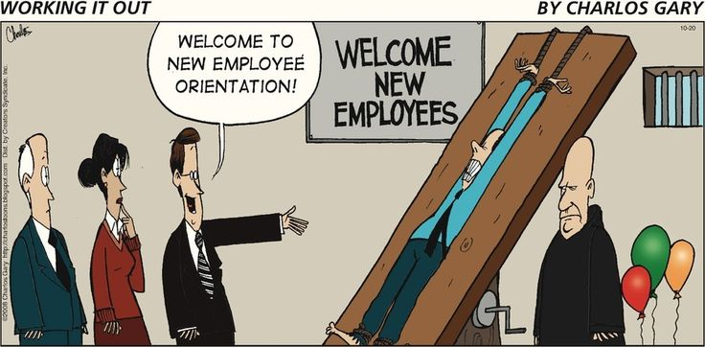
Notes:
Rarely is a process really good though.
What can we do?

Slide 33
Great Onboarding Experiences
Prep for them ahead of time
Notes:
You know they’re coming… you’re the team that hired them
Get the computer mostly ready
If it needs software, either have it ready with keys if needed
Or have easy to access place with all the software
Maybe a github repo with a provisioning script to download/install it all
Logins should be tested if possible
It’s super annoying to have to wade through tech support the first day
Have desk ready and clean
Seriously, I’ve moved into disgusting desks. Dusty, several year old can of coffee, etc.
Besides being easy and convenient, it makes them feel welcome

Slide 34
Great Onboarding Experiences
Get together as a team on first day or two
Notes:
… and I don’t mean to work
Play a card game
Go to lunch
Just talk about backgrounds and where you came from
Go get ice cream (I did that with a team once)
This builds a good vibe with the team. If you care enough to spend time learning your new teammate, it reduces their stress, but also provides more of a safe feeling for them to be included
Less like “token new person”
(We all hate being the NEW person)

Slide 35
Great Onboarding Experiences
Provide a mentor who will willingly answer questions
Notes:
This is huge. The “Ugh, who is going to mentor the new person? No one?” is not a vibe you want to have
This person should be easily available (desk nearby, chat client), etc.
You don’t have to be instanteously available (don’t want to break “the zone”) but they should have a way to get answers easily

Slide 36
Great Onboarding Experiences
Pair with them in the beginning
Notes:
There’s no better way to figure out how the team works than letting them see what you do. Then letting them do it too.
If you already are a pairing team, spend some extra time with them in the beginning (don’t trade pairs as often)
You can even pair on non-code-related things
If you’re a mobbing team, maybe sit out with them for a little bit and show them how everything works, or let them watch the mob a bit first before diving in head first.

Slide 37
Great Onboarding Experiences
Check in with them at least once a week
Notes:
This isn’t a “how’s it going? … That’s good. Have fun.” kind of thing
Actually check in.
How are you doing?
Are things making sense?
What can I explain better?
Are there things I can provide to help things make more sense?
Often they don’t know what questions to ask, and can feel overwhelmed quickly. So check in! Even experienced people need this too.
There’s a LOT to absorb in a new job. We know that.
Ideally… more than one team member checks in too. (Team members can do it once, but new person gets more support)

Slide 38
Great Onboarding Experiences
Prep for them ahead of time
Get together as a team on first day or two
Provide a mentor who will willingly answer questions
Pair with them in the beginning
Check in with them at least once a week
Notes:
In review

Slide 39
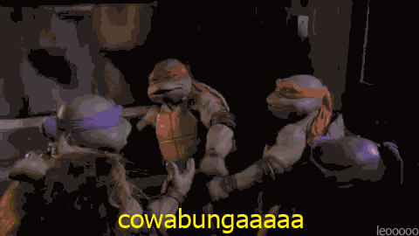
Notes:
Great! So they’re set up more to succeed, and the team is getting ready to benefit more from their involvement. What do we need to do now?

Slide 40
Effective Mentoring Practices
Because not everyone knows where the free snacks are
Notes:
I debated putting this section in my first version of this talk. After asking some managers and experienced dev friends, they said “DO IT! I DON’T KNOW HOW TO MENTOR!”
I knew just how important this was
If you made it to Olivia’s talk on Effective Mentoring earlier at Code Mash, you got a good dose of great tips.
I have my own summary of some specifically for new hires.
There’s three main things you need to know, and I’m going to dive into them.

Slide 41
Effective Mentoring Practices
First…
You need a good process
Notes:
Mentoring feels like two people sit at a table and magic happens. This isn’t the case. It takes some thought and diligence.

Slide 42
Mentoring - Good Process
You need a good process:
Good onboarding
Consistent and fair standards
Not relying on them to know what they need to know
Leaving opportunity to discover
Notes:
We talked about good onboarding. But a good onboarding is what helps start the mentoring process
Standards for how you’re looking at their work need to be consistent with what the other team does, but also fair.
Consistent in that you treat them the same way you treat other team members
Fair in that you don’t have high expectations up front. Those build up over time
New people almost never know what they need to know. “Do you have any questions?” almost always results in “no”. So it’s really 100% fine for them to literally not have a clue what to ask
While you should guide them along in the beginning, leave room for them to learn things and try out stuff.
If you’re pairing, let them fail sometimes and guide them to the right way to do it. (They learn by doing)
Give them time to play with your software, learn what it does, see other people use it, etc.

Slide 43
Effective Mentoring Practices
Second…
You need good communication
Notes:
I’ve heard so many talks here on communication being a major key to success. Same thing here. What does this look like?

Slide 44
Mentoring - Good Communication
Schedule 1:1 meetings early and often
And ask good questions
Reiterate that learning company procedures takes time
Check on confused looks
Notes:
Don’t wait a month or two to do 1:1 meetings. Start them early! I had one my first week of this job.
“How’s it going?”
“What are you learning?”
“What’s going well right now?”
“What’s not going so well right now?”
“What can I or the team help you with to be better?”
Remember that learning your company’s processes takes time. And if they forget things, it’s ok
I feel like I stumble awkwardly at every new job for a while
I also feel like things taught to me in orientation don’t always hold true in actual work
Check on confused looks
They don’t mean “I understand”. Ask what’s wrong. Ask what you can re-explain.

Slide 45
Effective Mentoring Practices
Third…
You need good guidance and visioning
Notes:
Mentoring really is about guidance. You want to help them learn what they need to do to be better and succeed. How do you start this off?

Slide 46
Good Guidance and Visioning
Make sure they have a project that’s doable
Pairing
Guidance on how to solve problems
Get juniors’ advice
Ensure new people actually understand the processes
Notes:
They should always have something to do from day 1. (You may not get to it on day 1, but it should be there.)
My last job didn’t give me a specific thing to work on for about 6 months
Pairing. Like I said before, letting them SEE how things work, and giving them guided opportunities to try is the perfect hand-on experience
Talk with them about how to solve problems. While they may have some experience on how they might approach something, they don’t know your system well enough to usually implement it yet.
My last job also did this… the way I would try to solve problems ended up being “wrong” because they had implemented stuff in some part of their framework already, but it was hard to tell
Get your less-experienced people to try to contribute on larger decisions
You’d be amazed at how well they could solve problems in totally different (and sometimes simpler) ways than you might
Ensure they ACTUALLY know the processes. It’s easy to hear a list of 10 things and say “yeah, I get it” then sit down to do them and remember only the 8th item to do.
Have them re-explain it
Have them write it down

Slide 47
Effective Mentoring Practices
Good Process
Good Communication
Guidance/Visioning
Notes:
Mentoring really boils down to these 3 things. If you can focus on them, and keep them in mind, I think not only will the new person benefit, but they’ll integrate into your team faster, and the whole team benefits from this.

Slide 48
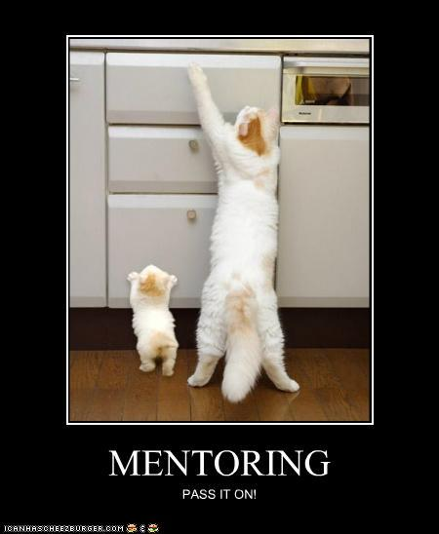
Notes:
Mentoring is great! Pass it on!
So you’ve brought on someone, you taught them the ropes, and they’re supported. This is great!
We need to do one more very, very important thing.

Slide 49
Iterate and Improve
I have to include at least one Agile term, right?
Notes:
We’re developers. Why not make this into an Agile process?
But doing all of the above work is really not beneficial to the future if you don’t iterate and improve this process

Slide 50
Iterate and Improve
Before you start hiring: plan your “sprint”
Notes:
Your “sprint” (if you will) is probably the time period of start to finish.
Where start is pre-planning your hire (the first part of this talk)
And where end is 3-6 months into this (this part of the talk)
Plan this out
I’d recommend documenting what you plan to do, so every part of the first part of this talk
If you hire often, this may encompass more than one person at a time (ex: 5 people a week)

Slide 51
Iterate and Improve
Hold a retrospective after about 3-6 months (and include the new team member)
Notes:
A retro is going to tell you what went well, what didn’t go well, what to keep doing, and what not to keep doing.
As a team, you can probably see what happened if it was a rough process, or see how well it worked if you had great candidates and you made a good choice
And INCLUDE the new person! They had to endure the process, they can tell you what to do to make it less exhausting, easier on them, and maybe some other things
This worked at my last job. When I finally told them I was job hunting, they revamped their interview process to find someone that would be a better fit and not with incorrect assumptions

Slide 52
Iterate and Improve
Document your retrospective
Notes:
You probably document your regular team retros… do it here too!
Why is this important?
It helps you remember what to do next time (if you don’t hire often)
It helps other teams get ideas on how to improve
If you do hire often, your process is probably more complicated. Documenting will help everyone in the process see what to do to improve.

Slide 53
Iterate and Improve
Improve for your next “sprint”
Notes:
Every interview can be better.
Every onboarding can be better
Every mentoring experience can be better
Use what you learned to improve on this! Why shouldn’t you make it better for everyone involved?

Slide 54
Iterate and Improve
Before you start hiring, plan your “sprint”
Hold a retrospective after about 3-6 months (and include the new team member)
Document your retrospective
Improve for your next “sprint”
Notes:
This should more or less look like what you do every 1-4 weeks anyway. Do this for your hirings and onboardings. I think you’ll see it makes a difference.

Slide 55

Notes:
As my friend Allison says, “Team work makes the dream work!”

Slide 56
Conclusion
Wake up! Here’s the takeaways!
Notes:
[READ]

Slide 57
Conclusion
Choosing Good Team Members
Great Onboarding Experiences
Effective Mentoring Practices
Iterate and Improve
Notes:
These are the 4 main things you need to keep in mind.
These things will not only build your team, but build it to last.
The new people will benefit immensely from this help
The team will grow and be a better and more productive in the long run
Your company will get better at this process as you keep doing it, whether you’re a small company or a large one
It’s a lot of stuff I went over, but you know what?

Slide 58
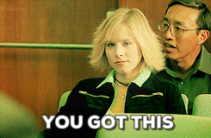
Notes:
YOU GOT THIS!

Slide 59
Thanks!
Got questions?
@geekygirlsarah
hello@geekygirlsarah.com
Find me around the halls
Notes:
I’m Sarah Withee
Geekygirlsarah on social media
I’m happy to chat afterward up front or in the hallway
Go! Be awesome!
Thank you!
[STOP]

Slide 60
Credits
Special thanks to all the people who made and released these awesome resources for free:
Presentation template by SlidesCarnival
Title font: Patrick Hand SC (https://www.fontsquirrel.com/fonts/sniglet)
Body font: Sniglet (http://www.1001freefonts.com/patrick_hand_sc.font)
Notes:
Reference slide (not shown)

Slide 61
Presentation design
This presentation uses the following typographies and colors:
Titles: Patrick Hand SC
Body copy: Sniglet
You can download the fonts on these pages:
https://www.fontsquirrel.com/fonts/sniglet
http://www.1001freefonts.com/patrick_hand_sc.font
You don’t need to keep this slide in your presentation. It’s only here to serve you as a design guide if you need to create new slides or download the fonts to edit the presentation in PowerPoint®
Notes:
Reference slide (not shown)

